Slide 1
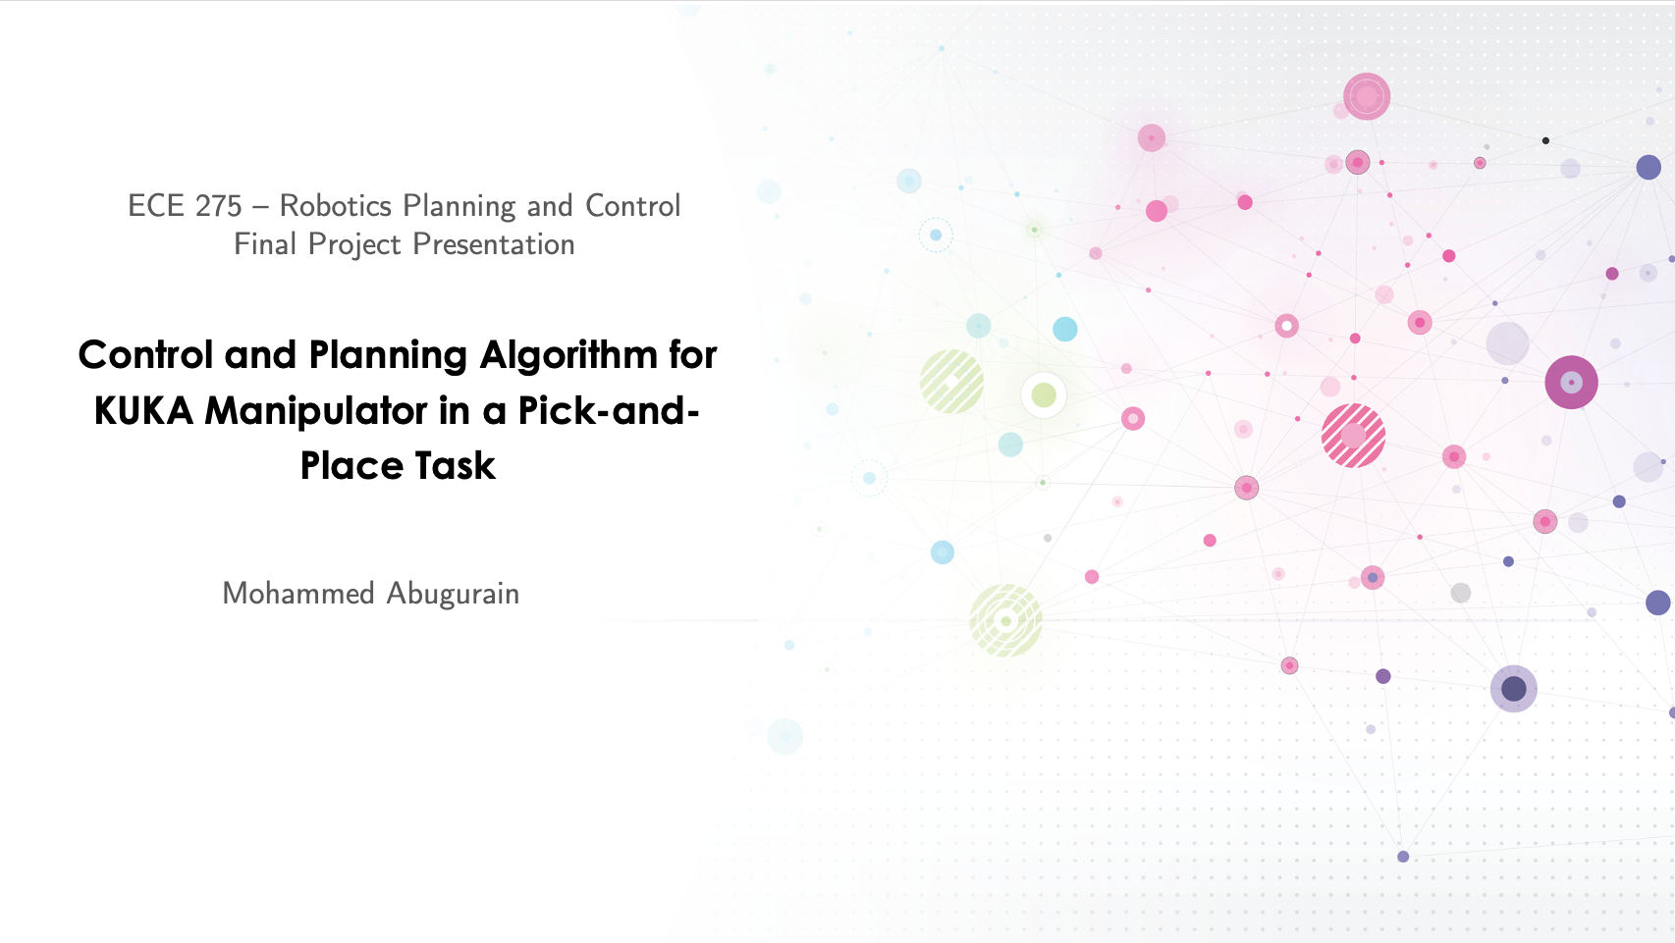

Slide 2

Presentation Outline
Problem Formulation & Objectives
Midterm Progress Recap
Solution
Results and Discussions
Challenges and Potential Improvements
Conclusion

Slide 3
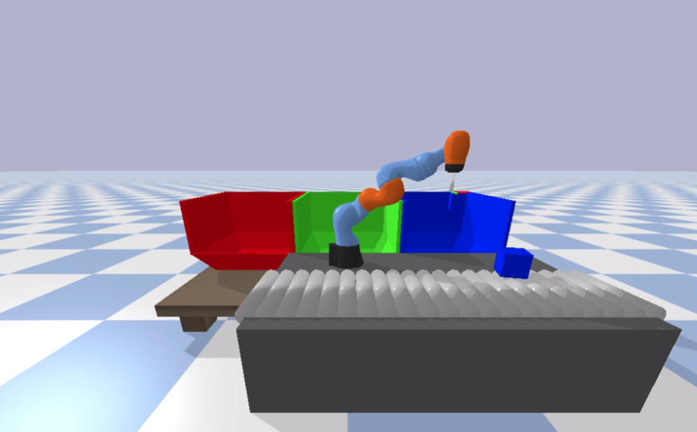
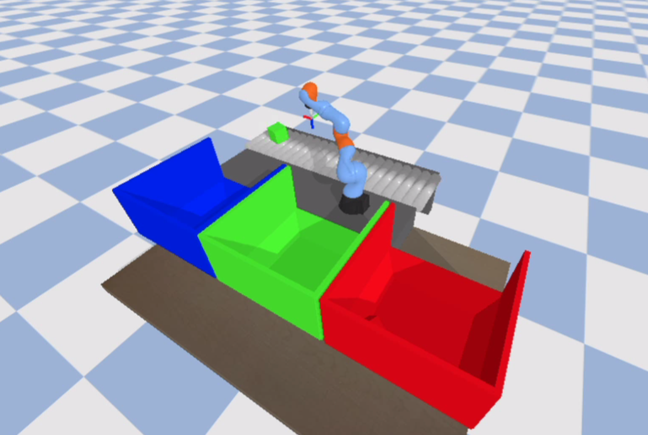
Problem Formulation & Objectives
Develop a joint torque controller
Design a planning algorithm
Optimize the algorithm to handle random variations
Integrate the controller and planner.
Figure. 1 Front view of the problem setup
Figure. 2 Back view of the problem setup
Notes:
The goal of this project is to design a control and planning algorithmfor a manipulator robot to efficiently pick and place color-coded cubes onto trays with matching colors. The cubes are moving on a conveyor system, and the robot must account for the conveyor's randomly assigned roller speed and drop-off locations.

Slide 4
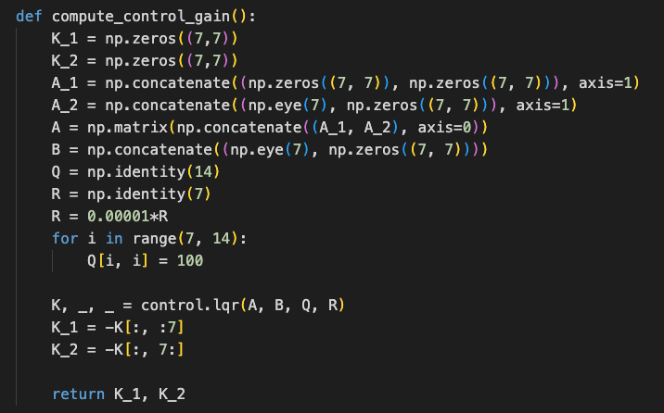
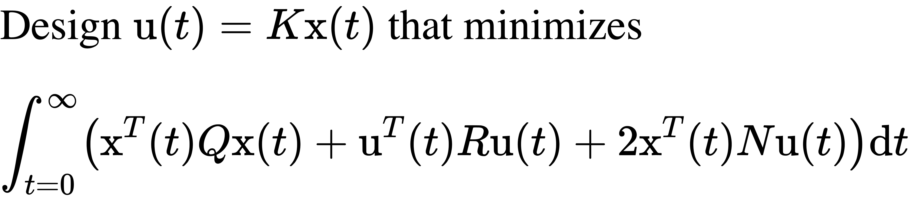
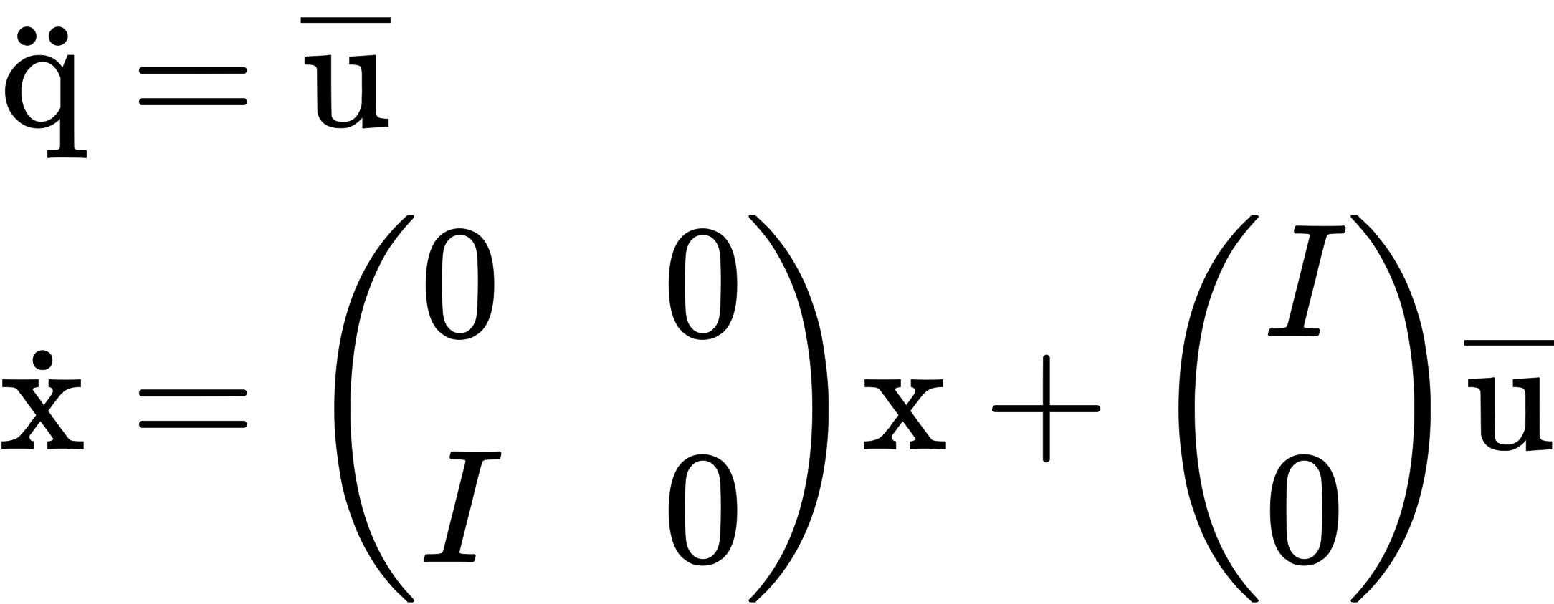
Midterm Recap: LQR Controller Design
Figure. 3 LQR controller code snippet
Notes:
The goal of this project is to design a control and planning algorithmfor a manipulator robot to efficiently pick and place color-coded cubes onto trays with matching colors. The cubes are moving on a conveyor system, and the robot must account for the conveyor's randomly assigned roller speed and drop-off locations.
way of finding an appropriate state-feedback controller

Slide 5
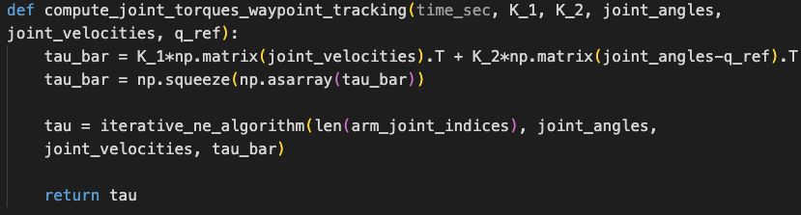
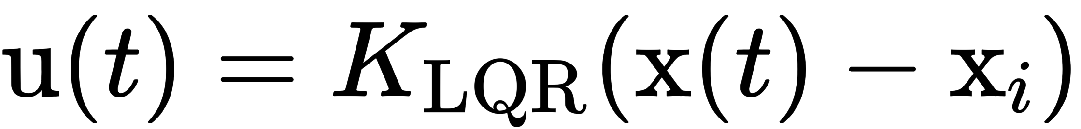
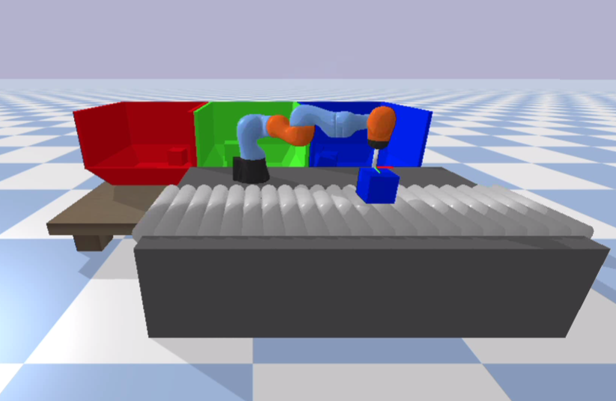
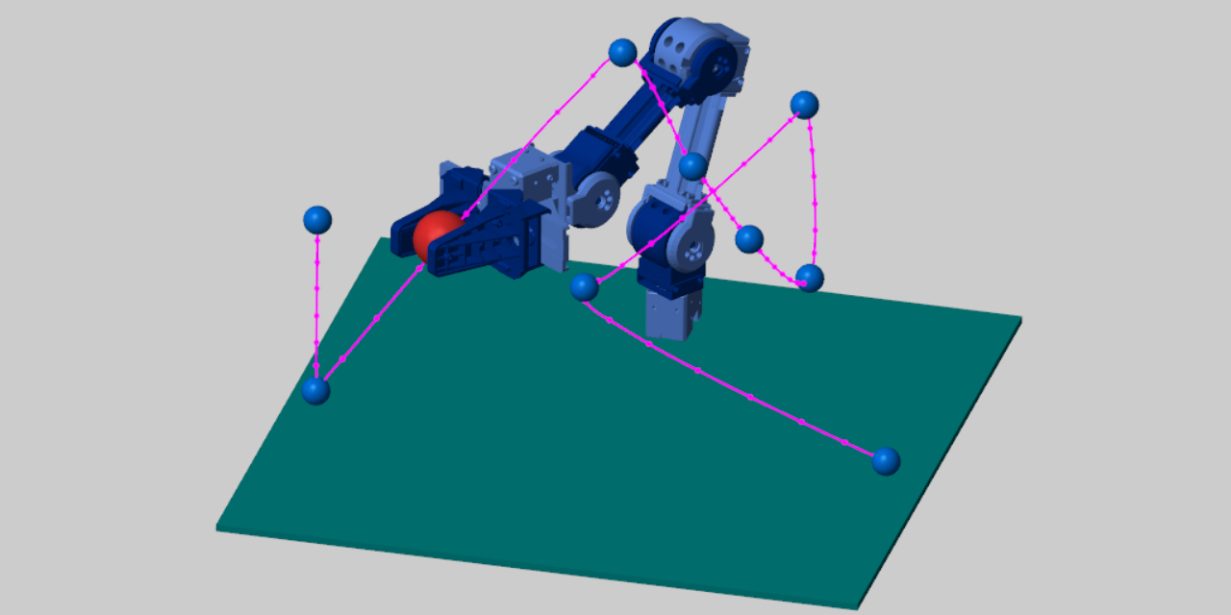
Midterm Recap: Waypoint Tracking
We will apply
Point B
Figure. 4 Waypoint tracking code snippet
Point A
Figure. 6 Waypoint tracking example
Figure. 5 Waypoint tracking example
Notes:
The goal of this project is to design a control and planning algorithmfor a manipulator robot to efficiently pick and place color-coded cubes onto trays with matching colors. The cubes are moving on a conveyor system, and the robot must account for the conveyor's randomly assigned roller speed and drop-off locations.
way of finding an appropriate state-feedback controller

Slide 6
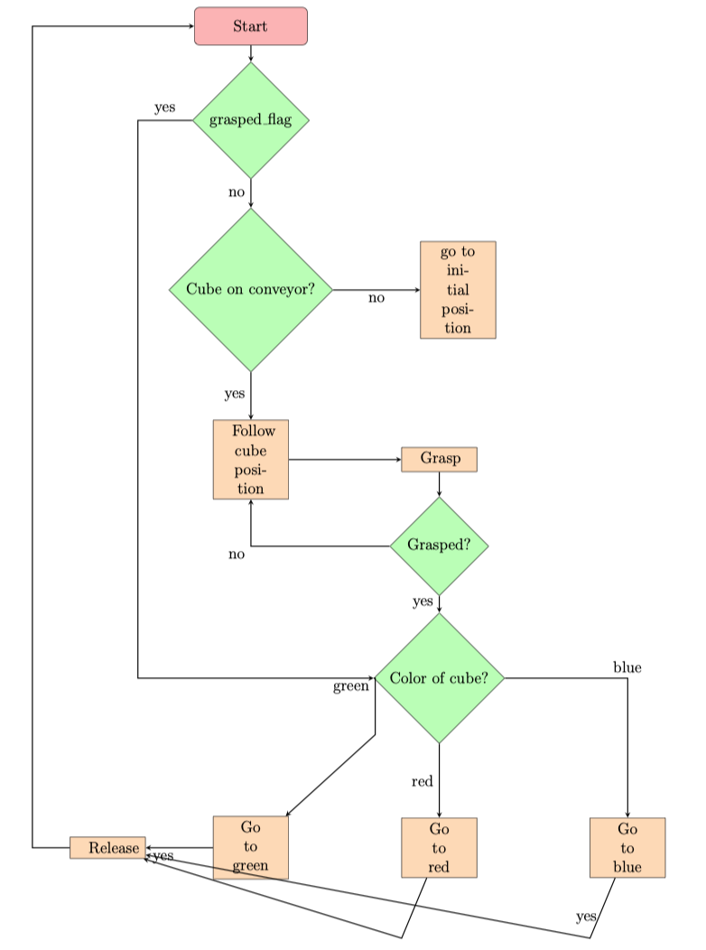
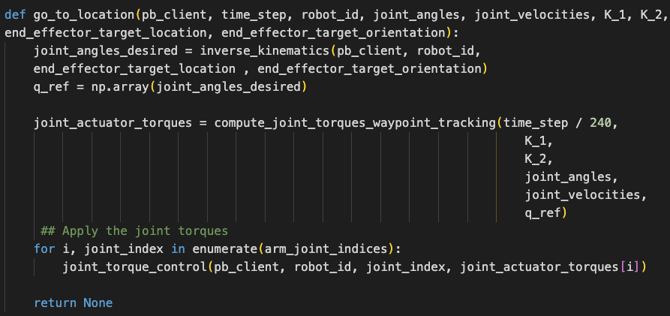
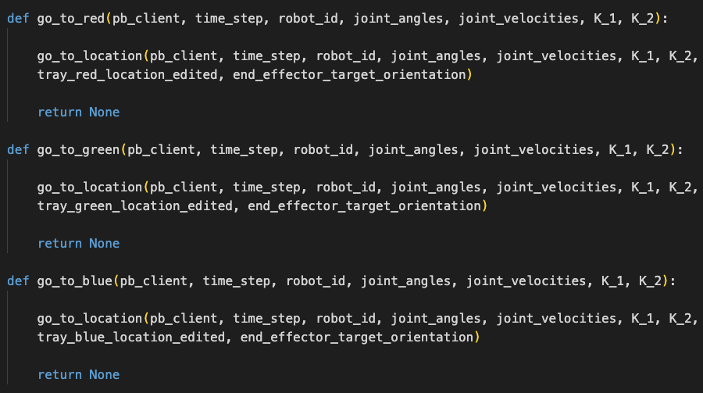
Midterm Recap: Algorithm Summary
Figure. 8 Go to anypoint code snippet
Figure. 9 Go to tray code snippet
Figure. 7 Algorithm Summary

Slide 7
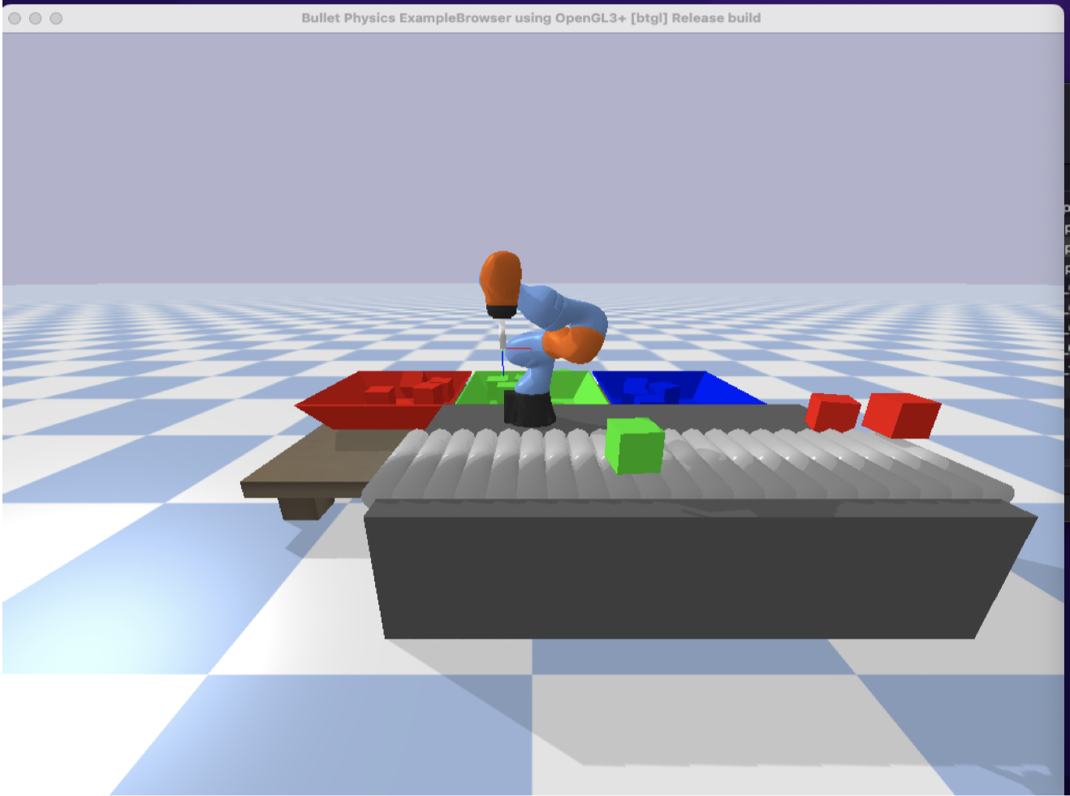
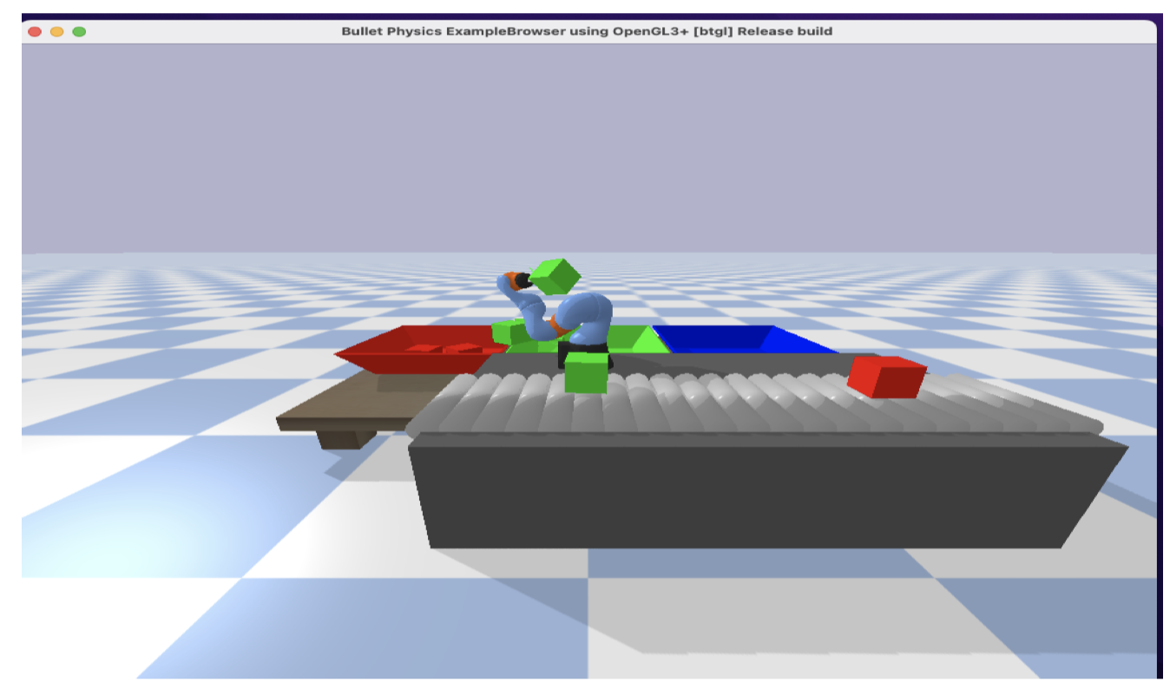
Midterm Recap: Results
Notes:
Add midpoints in the path to have smoother implementation.

Slide 8
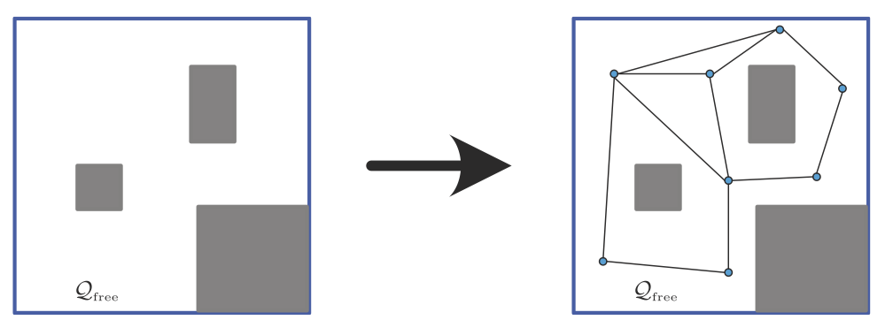
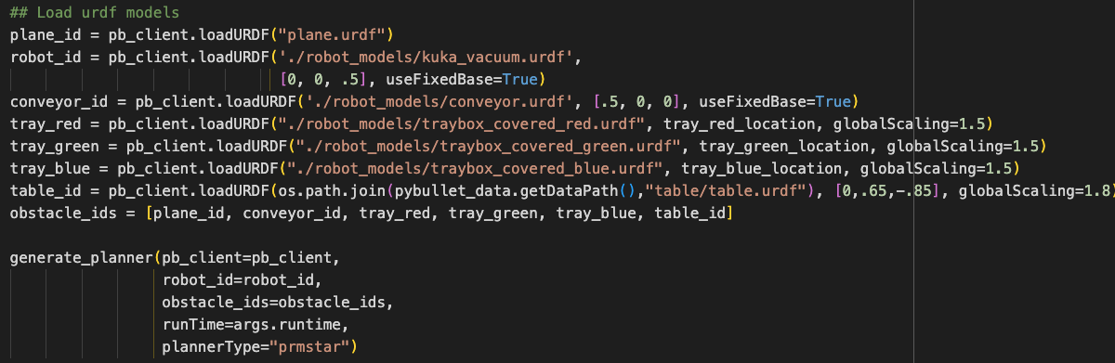
PRM* Planner
How to generate the trajectory?
Generate a probabilistic roadmap from the environment
Load the generated map
Connect the initial state and final state to the map
Figure. 10 Map generation example
Figure. 11 PRM* generation for our setup

Slide 9
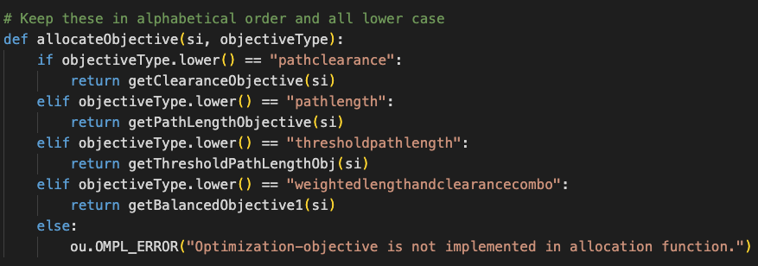
PRM* Planner Objective: pathclearance Vs pathlength
The path clearance objective in OMPL focuses on finding a trajectory for your manipulator robot that not only avoids collisions but also keeps a safe distance from obstacles.
The path length objective aims to find a trajectory for the robot that minimizes the total distance traveled between the start and goal configurations.
Figure. 12 PRM* generation objectives

Slide 10
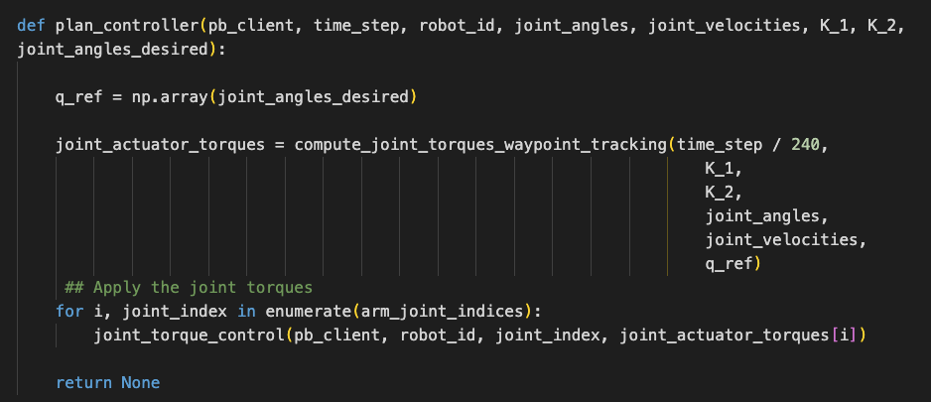
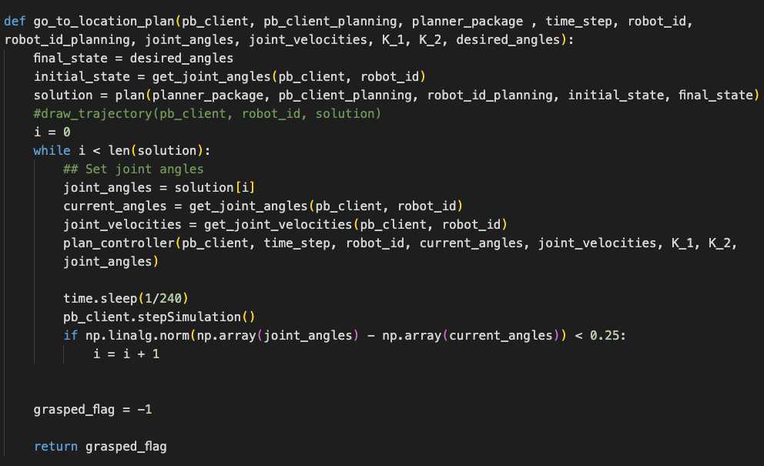
Planner-Controller Integration
Figure. 13 Code snippet for controller implmentation
Figure. 14 Code snippet for planner-controller integration

Slide 11
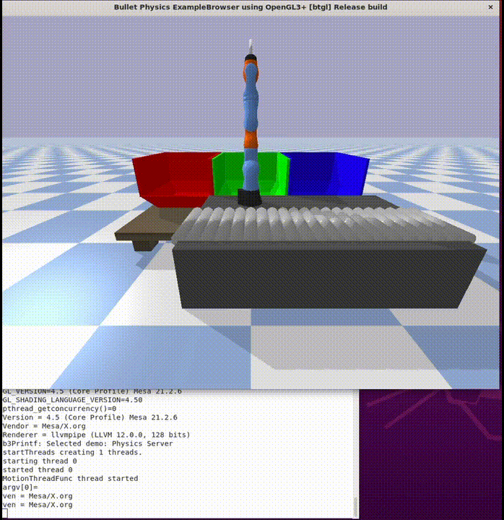
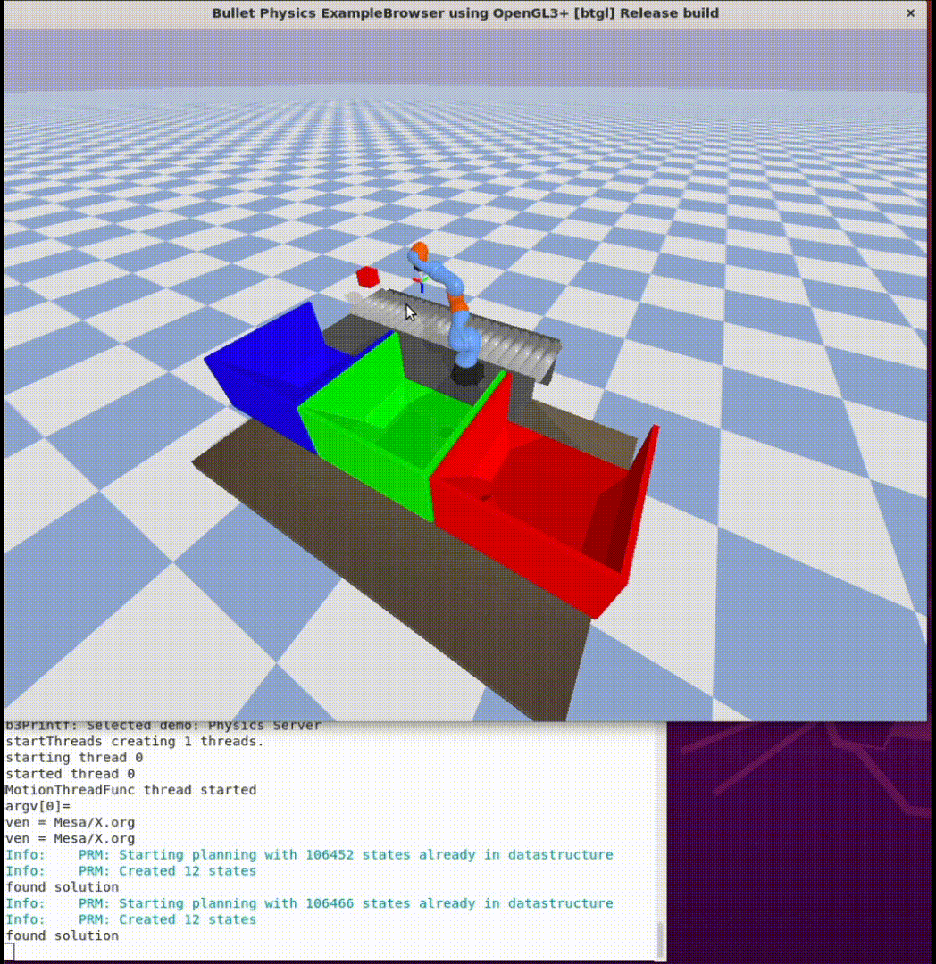
Results & Discussion
Figure. 15 Front view results
Figure. 16 Back view results

Slide 12
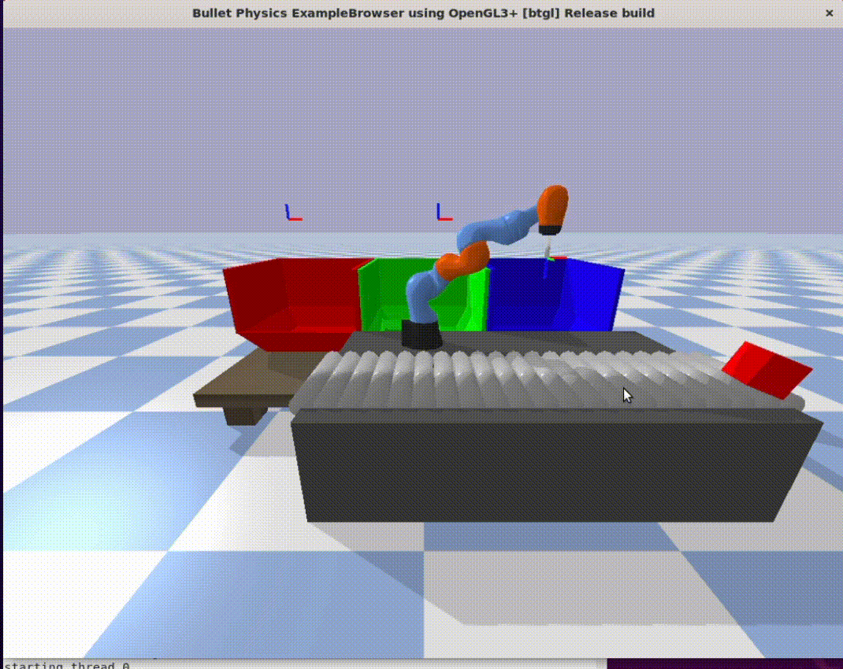
Challenges and Potential Improvements
Hyperparameters tuning (When to pick up, where to drop, initial position, LQR parameters …)
Dropped boxes
Robustness and reducing the sensitivity
Deep RL implementation
Figure. 16 Cube dropping problem
Notes:
Inertia

Slide 13
Conclusion
Successfully designed and implemented a control and planning algorithm for a manipulator robot to perform pick-and-place tasks with color-coded cubes on a conveyor system.
Developed an LQR joint torque controller
Used the Probabilistic Roadmap (PRM) algorithm with the path clearance objectives
Integrate both the planner with the controller to achieve the pick-and-place problem

Slide 14
Thank you for listening ☺

